Slide 1

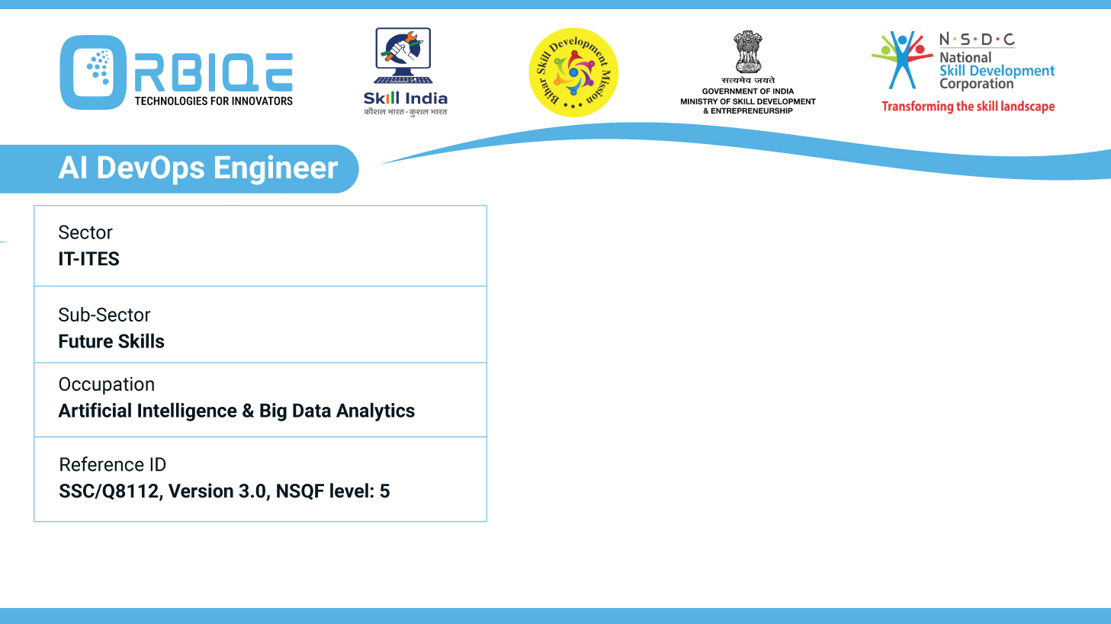
Name- Krishna Kant Dubey

Slide 2

Creating Staging/ Testing Environments for Production

Slide 3
Agenda
Establish staging environments
Validate changes

Slide 4
Establish staging environments

Slide 5
Validate changes

Slide 6
Thank You

